Slide 1
Diabetes Prediction from Health Indicators
Celia Harris & Anirudh Hedge
Group 24
5th April 2024

Slide 2
Contents
Project Overview
Problem setting & definition
Data source & description
Data Exploration
Data Mining Tasks
Data cleaning & processing
Dimension reduction
Model Performance Evaluation & Selection
Project Results & Insights
Performance evaluation results
Impact of project outcomes
Conclusions & future work

Slide 3
Problem Setting
Diabetes is a chronic disease that affects 11.6% of the US population
25% of people with diabetes are unaware they have it
Diabetes results from an inability of the body to regulate glucose levels
If diabetes is not diagnosed & treated at an early stage, life-threatening complications can develop
Health & lifestyle data may be useful in predicting whether a patient is at high risk of developing diabetes

Slide 4
Problem Objectives
Determine which risk factors are the most useful & accurate in predicting diabetes risk
Determine whether a patient is likely to develop diabetes based on risk factors

Slide 5
Data Source & Description
Target variable: binary variable indicating whether a patient has diabetes (1) or not (0)
Predictors: 14 categorial (binary) & 7 numeric variables
Dataset shape: 253,680 rows and 22 columns
Data Source: ‘Diabetes Health Indicators Dataset’
From the Behavioral Risk Factor Surveillance System (BRFFS) annual survey that collects health related data from US citizens.

Slide 6
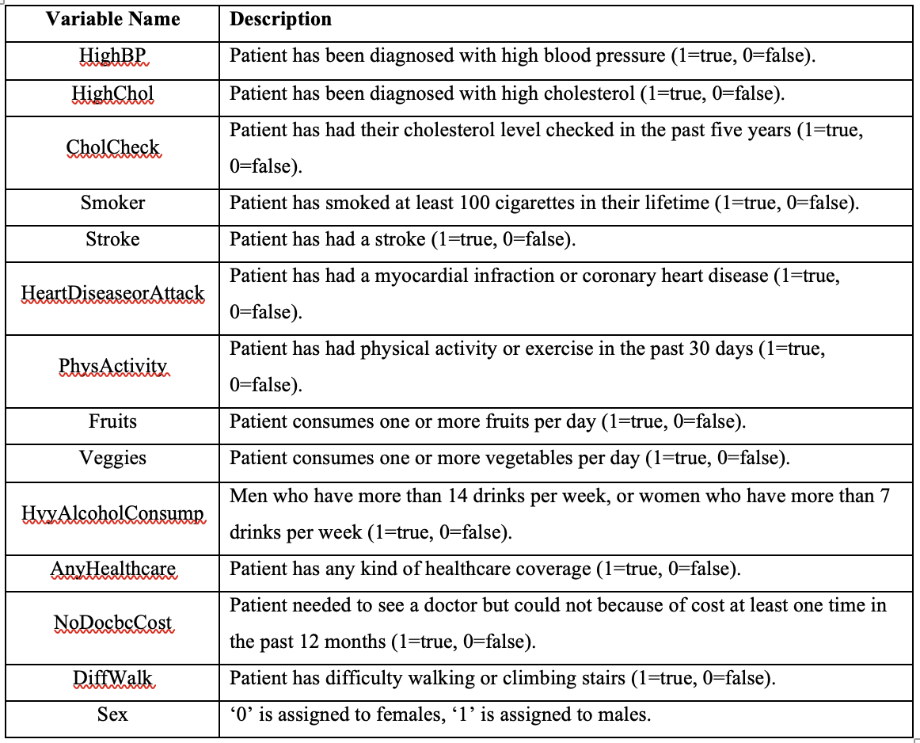
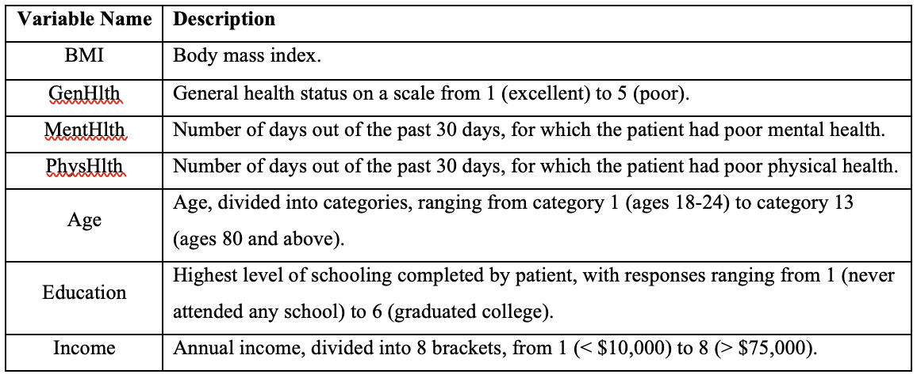
Variable Description
Categorial Variables
Predictor variables consist of health and lifestyle factors that are potential precursors to diabetes.
Numeric Variables

Slide 7
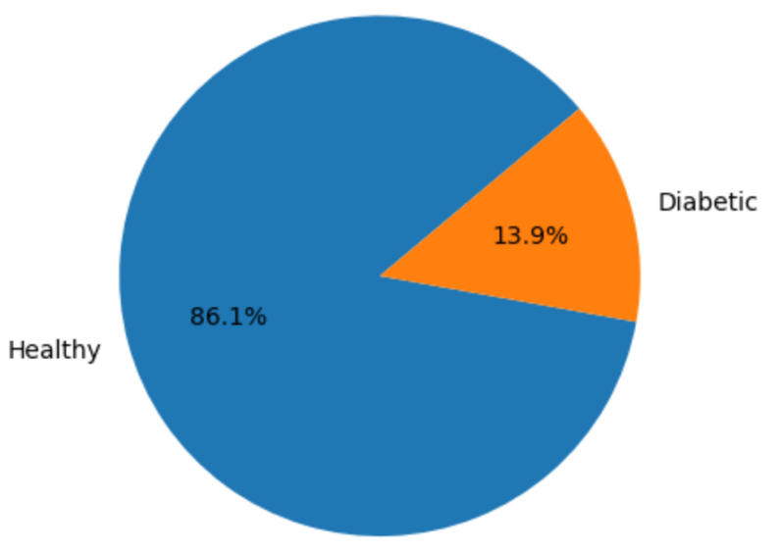
Data Exploration
The dataset contained no null values
The data consisted of 13.9% of diabetic patients and 86.1% of non-diabetic patients
In the US, about 11.6% of the population has diabetes
The prevalence of diabetes in the dataset and in the broader population are similar
Pie chart showing prevalence of categories within target variable.

Slide 8
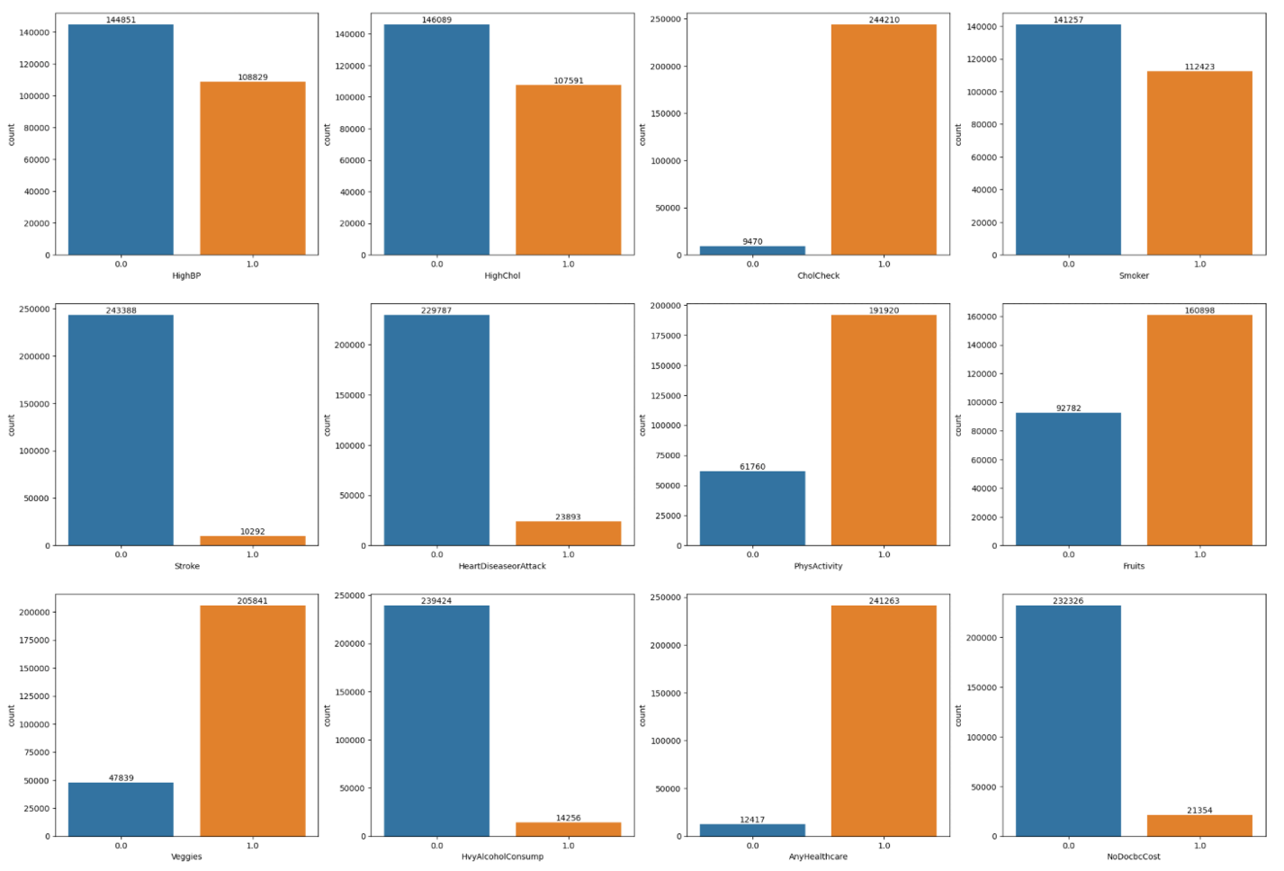
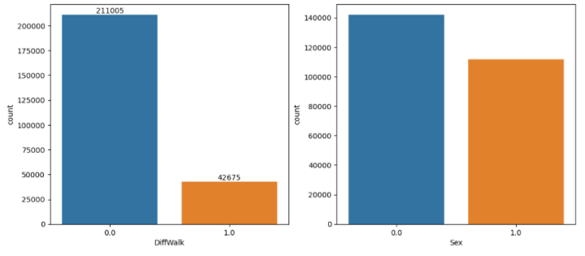
Data Exploration
Count plots were generated for each binary predictor variable.

Slide 9
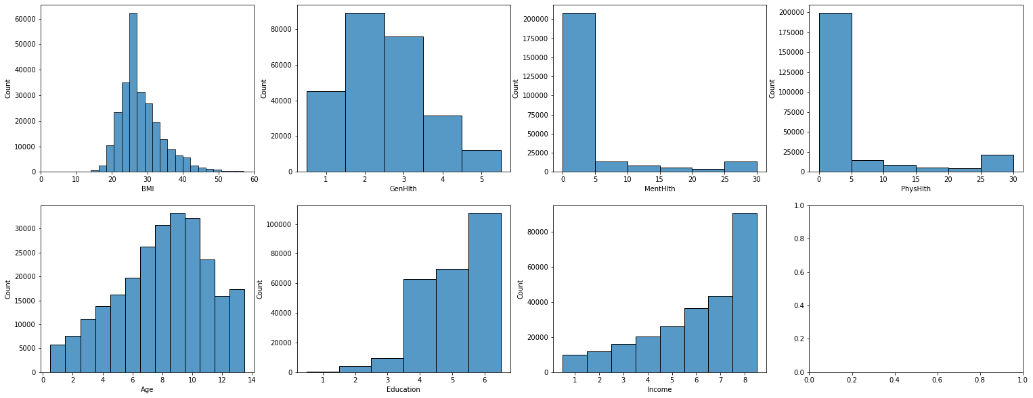
Data Exploration
Histograms were generated to examine the distributions of each numeric predictor variable.

Slide 10
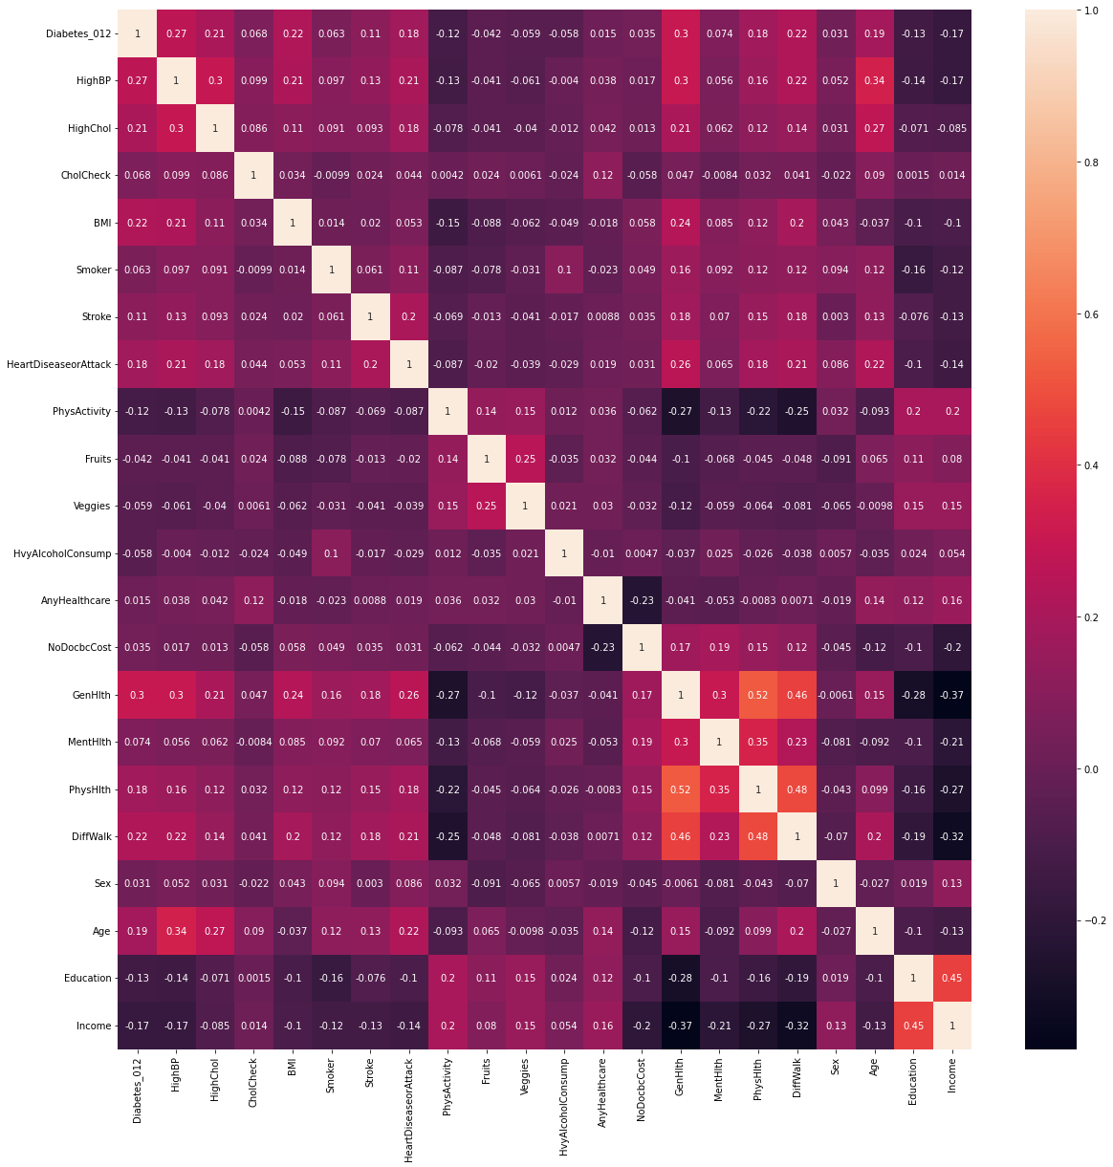
Data Exploration
A correlation heat map was generated for all variables.

Slide 11
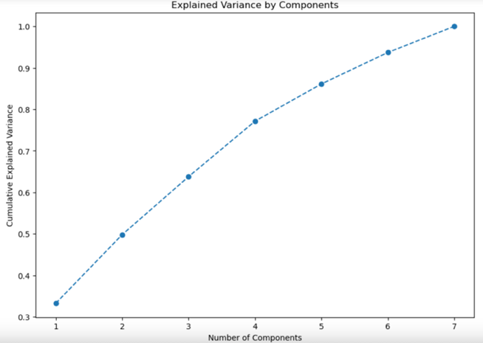
Data Mining Tasks
Principal Component Analysis
PCA performed on the 7 numeric predictor variables
All 7 variables must be retained to capture 95% of the total variance.
Cumulative proportion of explained variance reaches 95% with all 7 components.

Slide 12
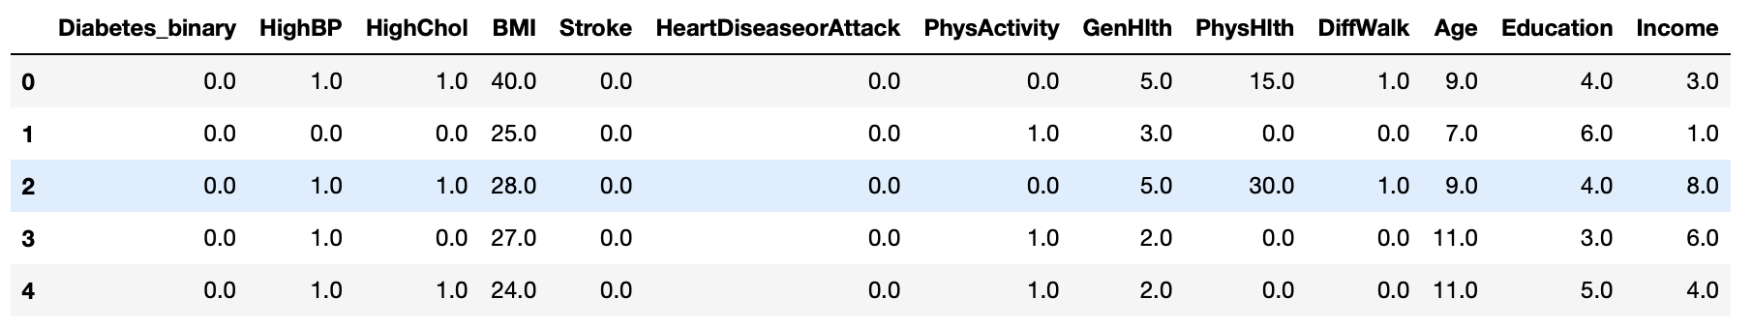
Data Mining Tasks
Chi-Square Test
Chi-square test was used to examine the associated between each categorical variable and the target
9 variables were dropped due to non-significant association with target variable
The cleaned dataset contains 13 predictors, reduced from total of 22.

Slide 13
Data Mining Model Exploration
The following models were used to classify the risk of Diabetes in the Patients:
K-Nearest Neighbors(K-NN) – It utilizes similarity between data points to classify diabetes presence
Classification Tress – It segments the dataset into subsets using decision nodes
Naïve Bayes – It applies probabilistic learning based on feature independence
Logistic Regression – It models the probability of diabetes as a function of health indicators
Neural Network – It leverages a layered architecture for complex pattern recognition
Random Forest – An ensemble method that operates by constructing a multitude of decision trees
We split the dataset into 70% training set and 30% test set

Slide 14
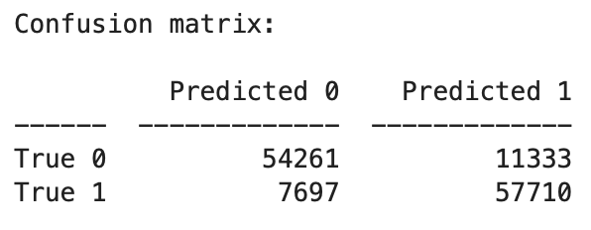
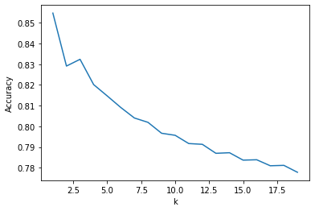
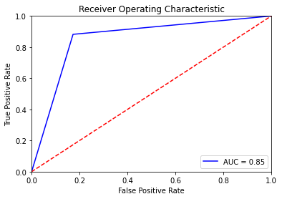
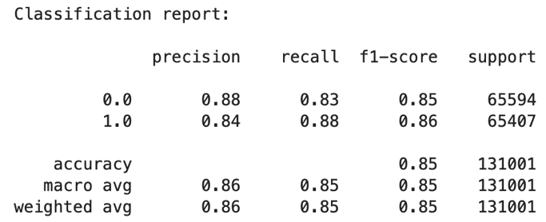
Performance Evaluation: k-NN
Different k - values ranging from 1 - 20 were analyzed to find the optimal k
Optimal K value to achieve the highest accuracy is k = 1
The model provided the accuracy of 85.47%
Fig : Model accuracy at various k values
Fig : Confusion matrix and classification report for k-NN model
Fig: ROC for k-NN model

Slide 15
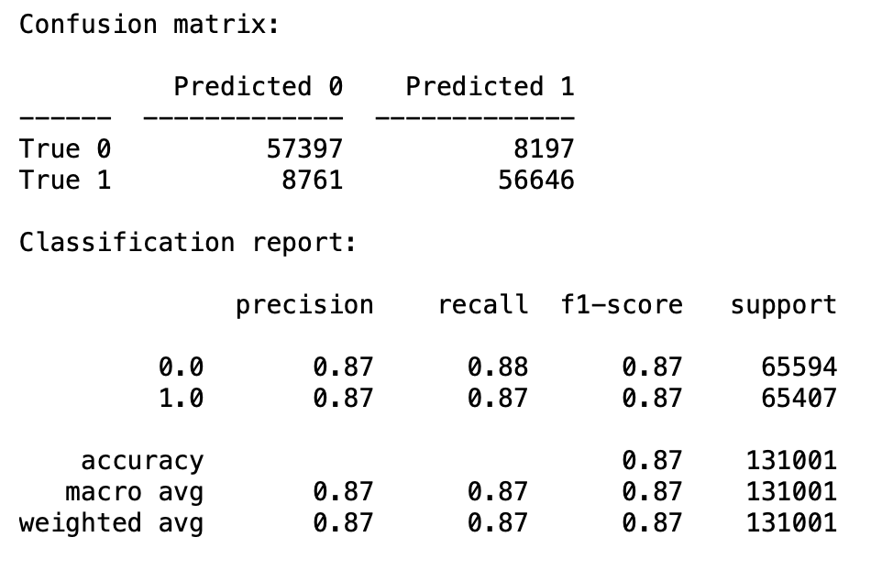
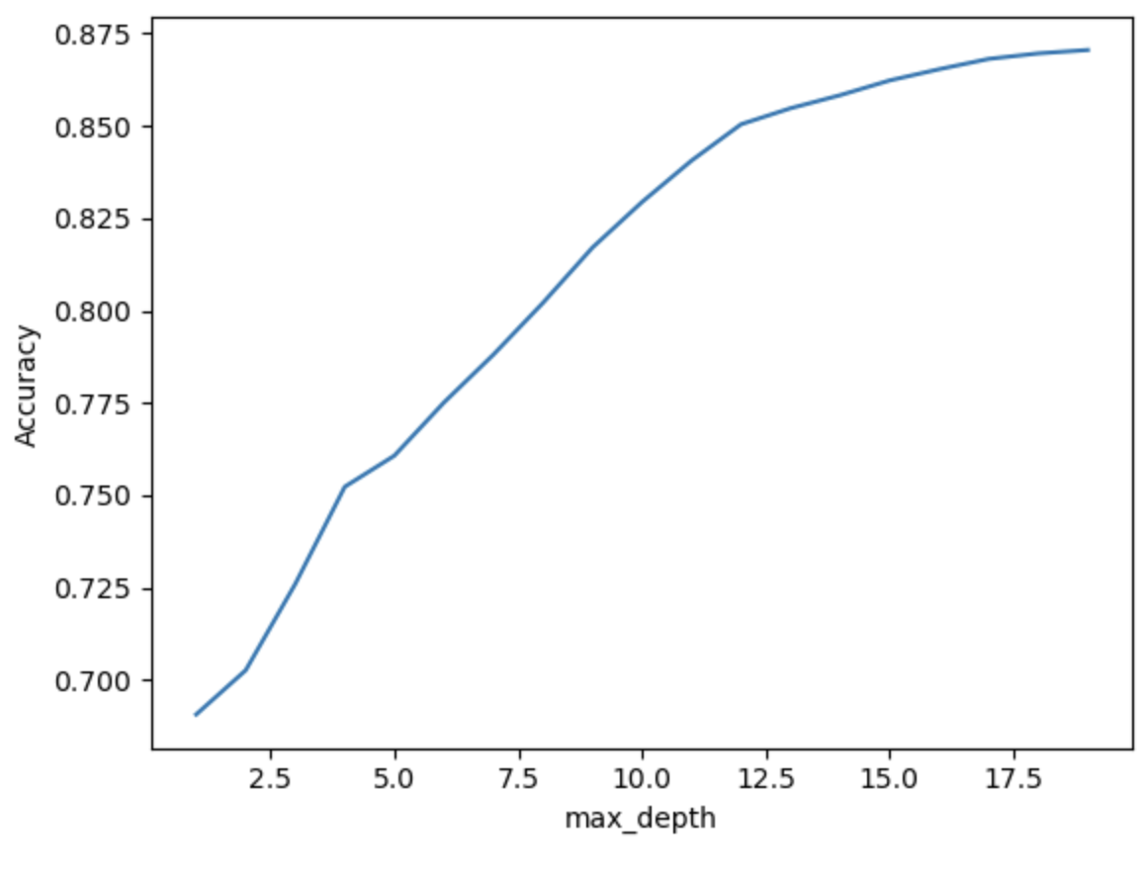
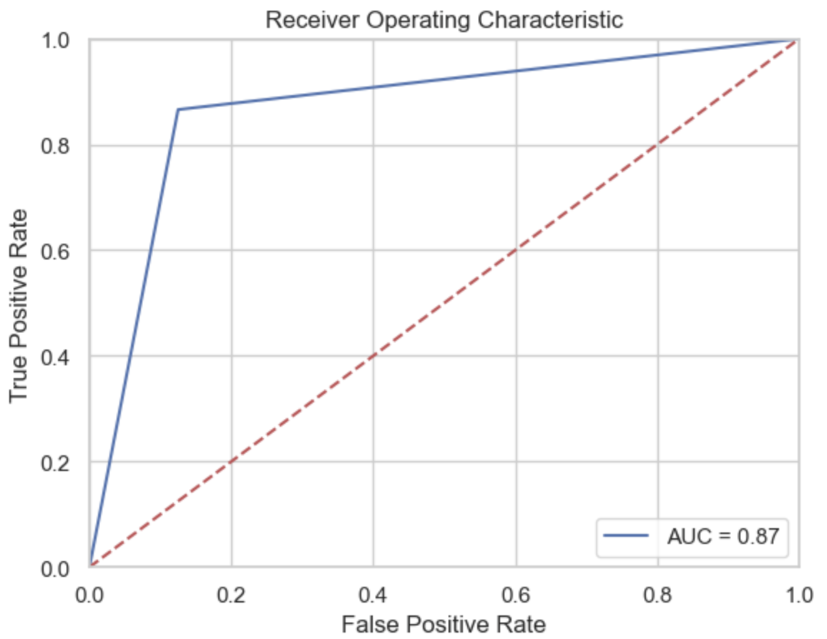
Performance Evaluation: Classification Tree
An iterative analysis was performed to determine the optimal maximum depth value to use
The highest accuracy of 87.05% was achieved at the depth of 19
Fig : Model accuracy at various maximum depth values
Fig : Confusion matrix and classification report for classification tree
Fig : ROC curve for Classfication tree

Slide 16
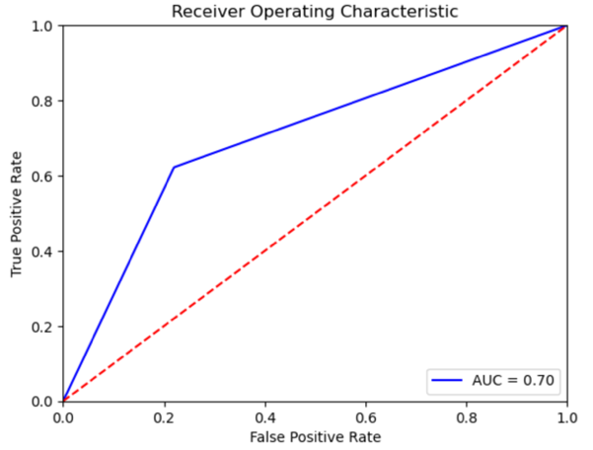
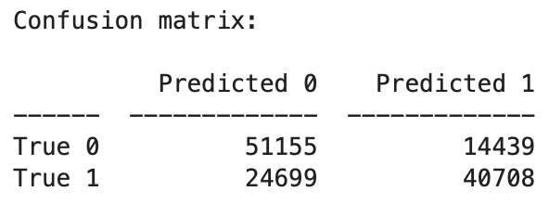
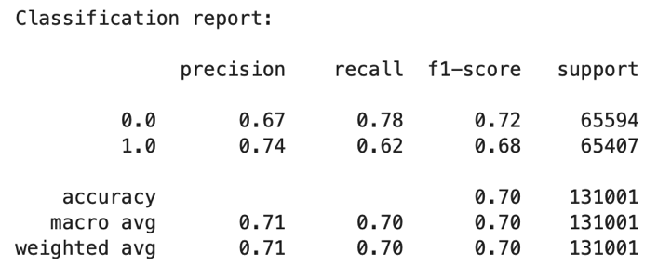
Performance Evaluation: Naïve Bayes
The performance of the model was the lowest among the models
The model only achieved the accuracy of 70%
Fig :Confusion matrix and classification report for Naïve Bayes
Fig : ROC curve for Naïve Bayes

Slide 17
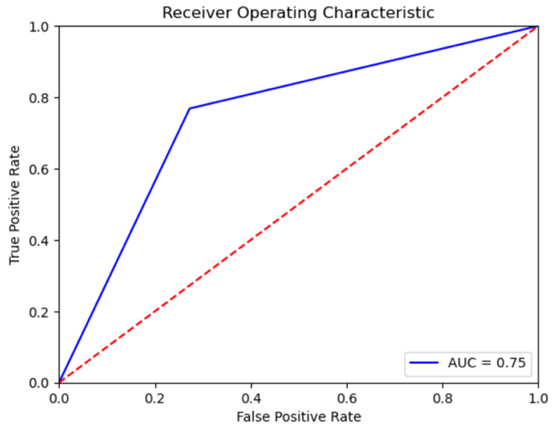
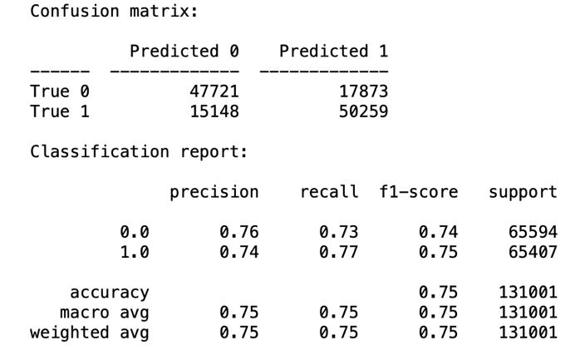
Performance Evaluation: Logistic Regression
The model achieved accuracy of 75% on the dataset
Fig : Confusion matrix and classification report for Logistic Regression
Fig : ROC curve for Logistic Regression

Slide 18
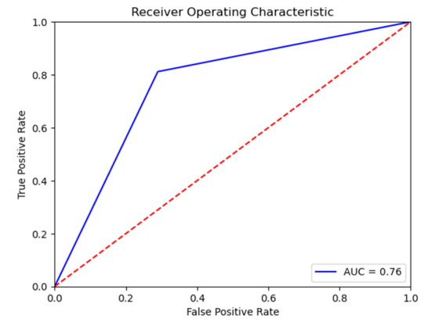
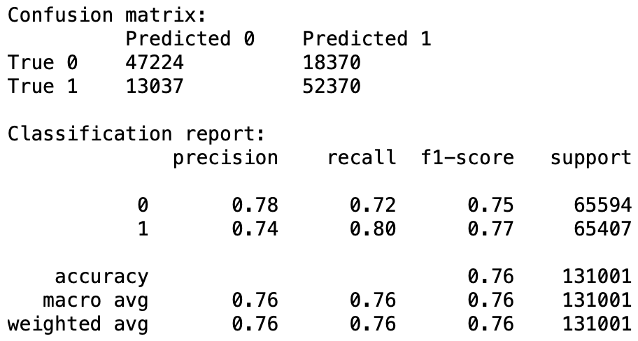
Performance Evaluation: Neural Network
The model achieved accuracy of 76 % which is comparatively less than most of the models
Fig : Confusion matrix and classification report for Neural Network
Fig : ROC Curve for Neural Network

Slide 19
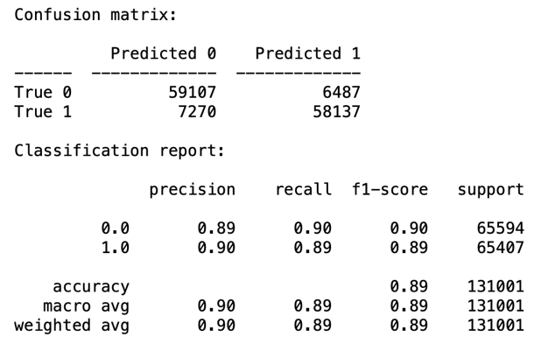
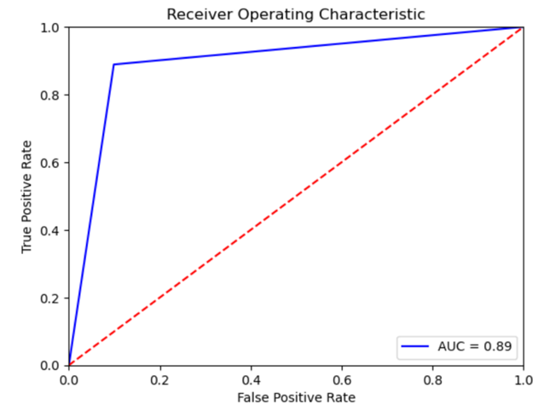
Performance Evaluation: Random Forest
The Model achieved the best performance among all the other models
Accuracy of 89% was achieved
Fig : Confusion matrix and classification report for Random Forest
Fig : ROC Curve for Random Forest

Slide 20
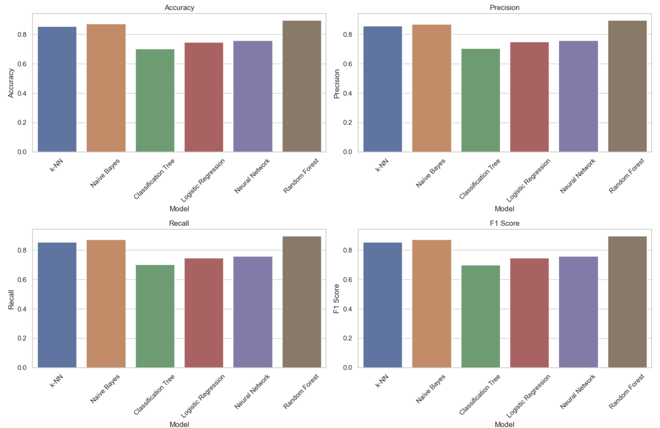
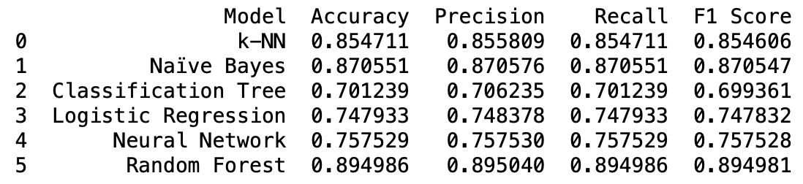
Project Results & Model Selection
The random forest model offers the best performance parameters among all the models
This model correctly classified 89% of all observations and has an error rate of 11%
Overall, these performance metrics suggest that the random forest model can identify diabetes cases with a high accuracy, while maintaining a balance between sensitivity and specificity

Slide 21
Impact of Project Outcomes
A model that can predict whether a patient is at risk of diabetes based on several simple health predictors is extremely useful.
Provides a simple & cheap way for patients to assess their own risk level
Encourages early-stage diagnosis and prevention of severe complications
Determines necessity for medical visits and diagnosis tests

Slide 22
Conclusions & Future Work
Conclusions
Future Work
The model is a highly beneficial tool for assessing diabetes risk
The model’s 11% error rate suggests patients cannot rely fully on the model, due to the chance of misdiagnosing a high-risk diabetes case
Reduce error rate to increase reliability
Find additional predictors that are better indicators of diabetes risk

Slide 23
Thank you!

